Slide 1
The Modern World
1901-Present

Slide 2
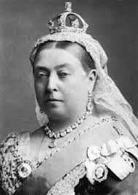
The end of the Victorian era
The end of the Victorian era was marked by the death of Queen Victoria in 1901.

Slide 3
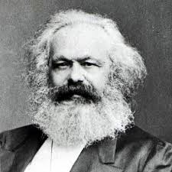
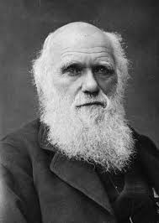
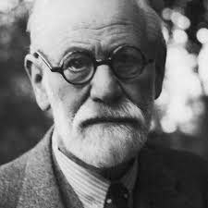
Were responsible for many of the social and intellectual changes taking place during this time
Karl Marx
Charles Darwin
Sigmund Freud

Slide 4
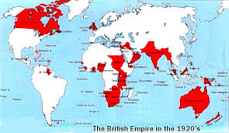
Colonies that gained their independence from Britain in the twentieth century:
Australia
South Africa
New Zealand
India – “Jewel of the Crown”

Slide 5
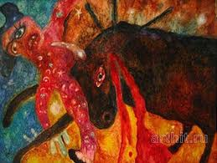
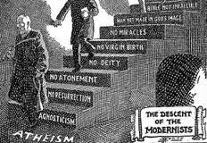
Modernism
Created by James Joyce
Explored sexuality and new conceptions of time and the workings of human consciousness

Slide 6
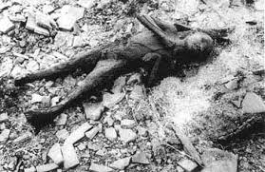
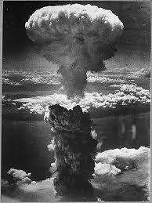
World War II
Ended with the atomic bomb being dropped on Hiroshima and Nagasaki
http://channel.nationalgeographic.com/explorer/videos/dropping-the-first-atomic-bomb/
http://channel.nationalgeographic.com/explorer/videos/devastating-radiation-effects/

Slide 7
1. How might you feel if you came under intense pressure to leave your homeland because life there had become intolerable?
2. Would you regard such a departure as an act of desertion, or as a wise investment in the future?
3. Do you think the speaker had much sympathy for Lot's wife?

Slide 8
Lot’s wife by Anna akhmatova
The just man followed then his angel guide Where he strode on the black highway, hulking and bright; But a wild grief in his wife’s bosom cried, Look back, it is not too late for a last sight
5 Of the red towers of your native Sodom, the square Where once you sang, the gardens you shall mourn, And the tall house with empty windows where You loved your husband and your babes were born.
She turned, and looking on the bitter view 10 Her eyes were welded shut by mortal pain; Into transparent salt her body grew, And her quick feet were rooted in the plain.
Who would waste tears upon her? Is she not The least of our losses, this unhappy wife? 15 Yet in my heart she will not be forgot Who, for a single glance, gave up her life.

Slide 9
Never shall I forget by elie wiesel
Never shall I forget that night, the first night in camp, that turned my life into one long night seven times sealed.
Never shall I forget that smoke.
Never shall I forget the small faces of the children whose bodies I saw transformed into smoke under a silent sky.
Never shall I forget those flames that consumed my faith for ever.
Never shall I forget the nocturnal silence that deprived me for all eternity of the desire to live.
Never shall I forget those moments that murdered my God and my soul and turned my dreams to ashes.
Never shall I forget those things, even were I condemned to live as long as God Himself.
Never.

Slide 10
http://www.poetryfoundation.org/poem/177017

Slide 11
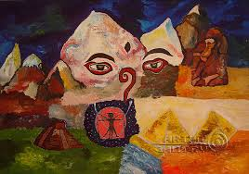
Vocabulary words to know
Subdued
Geniality
Untainted
Amiable
Condescension
Inaccessible
Indulgent
Haggard

